Slide 1


Slide 2
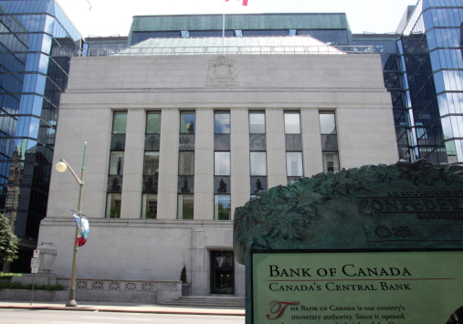
30
MONETARY
POLICY
Notes:
Notes and teaching tips: 7, 36,47, 60, 64, and 66.
To view a full-screen figure during a class, click the expand button.
To return to the previous slide, click the shrink button.
To advance to the next slide, click anywhere on the full screen figure.
Applying the principles of economics to interpret and understand the news is a major goal of the principles course. You can encourage your students in this activity by using the two features: Economics in the News and Economics in Action.
(1) Before each class, scan the news and select two or three headlines that are relevant to your session today. There is always something that works. Read the headline and ask for comments, interpretation, discussion. Pose questions arising from it that motivate today’s class. At the end of the class, return to the questions and answer them with the tools you’ve been explaining.
(2) Once or twice a semester, set an assignment, for credit, with the following instructions:
(a) Find a news article about an economic topic that you find interesting.
(b) Make a short bullet-list summary of the article.
(c) Write and illustrate with appropriate graphs an economic analysis of the key points in the article.
Use the Economics in the News features in your textbook as models.

Slide 3
After studying this chapter, you will be able to:
Describe Canada’s monetary policy objective and the framework for setting and achieving it
Explain how the Bank of Canada makes its interest rate decision and achieves its interest rate target
Explain the transmission channels through which the Bank of Canada influences real GDP, jobs, and inflation
Explain the Bank of Canada’s extraordinary policy actions

Slide 4
Monetary Policy Objectives and Framework
  A nation’s monetary policy objectives and the framework for setting and achieving that objective stems from the relationship between the central bank and the government.

Slide 5
Monetary Policy Objective and Framework
Monetary Policy Objectives
  The objective of monetary policy is ultimately political.
  It stems from the mandate to the Bank of Canada, which is set out in the Bank of Canada Act 1935.
  Basically, the Bank’s job is to control the quantity of money and interest rates in order to avoid inflation and, …
  when possible, prevent excessive swings in real GDP growth and unemployment.

Slide 6
Monetary Policy Objective and Framework
  Joint Statement of the Government of Canada and the Bank of Canada
  The agreement of 2011 is
The target is the 12-month rate of change in the CPI.
The inflation target is the 2 percent midpoint of the 1 to 3 percent inflation-control range.
The agreement will run until December 31, 2016.
  Such a monetary policy strategy is called inflation rate targeting.

Slide 7
Monetary Policy Objective and Framework
  Interpretation of the Agreement
  The inflation-control target is the trend CPI inflation rate.
  So the Bank has agreed to keep the CPI inflation rate at a target of 2 percent a year.
  But the Bank pays close attention to core inflation, which it calls its operational guide.
  The Bank believes that core inflation is a better measure of the underlying inflation trend and better predicts future CPI inflation.
Notes:
Emphasize the long-run harmony and short-run tension between the goals of monetary policy.
Note that popular discussion focuses on the short run.

Slide 8
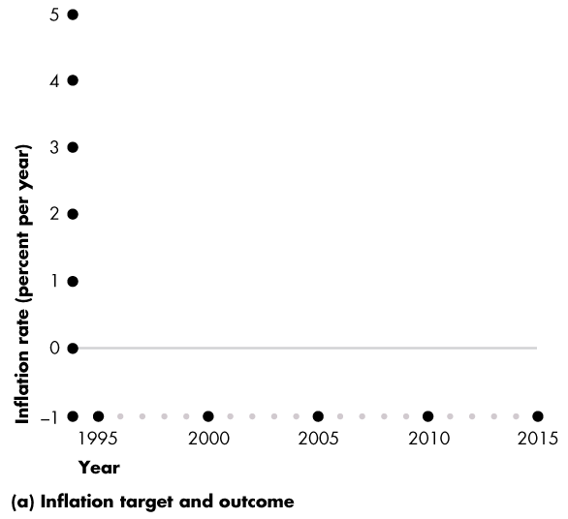
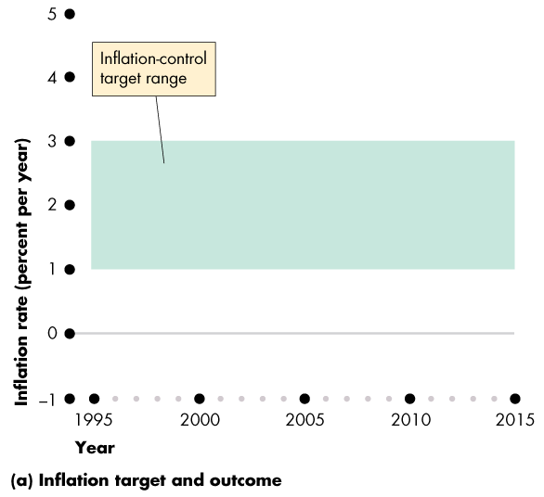
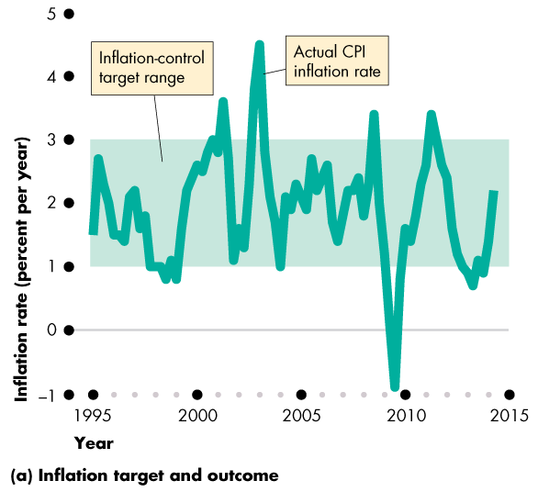
Monetary Policy Objective and Framework
Actual Inflation
Figure 30.1(a) shows the Bank’s inflation target.
The actual CPI inflation rate has only rarely gone outside the target range.
It shows no bias.

Slide 10
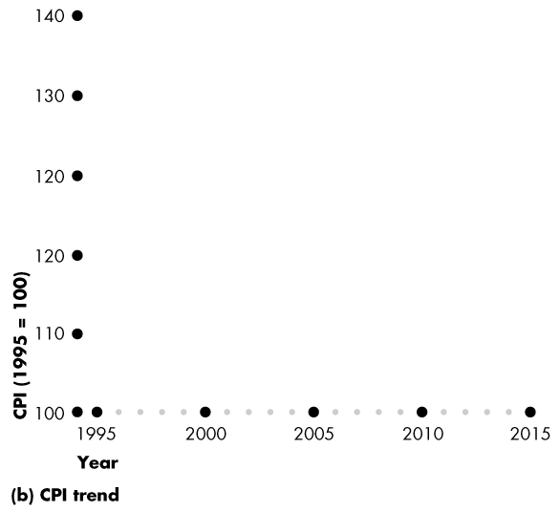
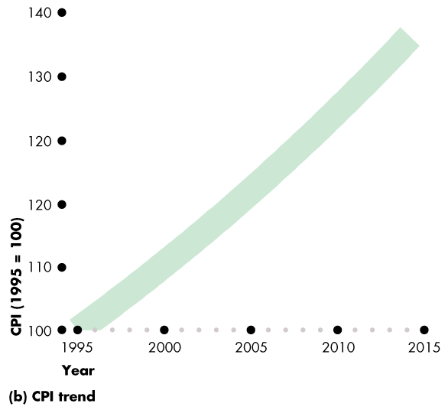
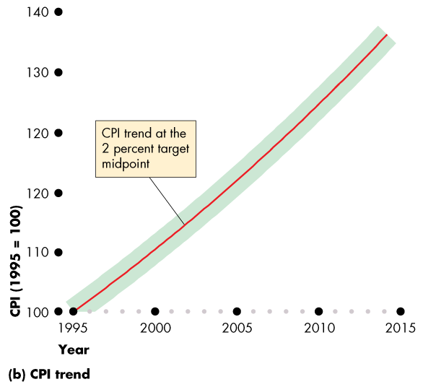
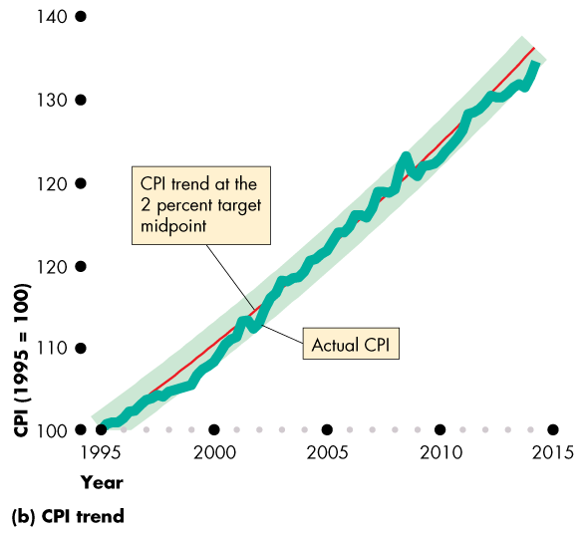
Monetary Policy Objective and Framework
  Figure 30.1(b) shows the trend inflation rate of 2 percent a year, at the midpoint of the target range.
  The Bank has done a good job of holding CPI inflation to its target, with only small and temporary deviations.

Slide 12
Monetary Policy Objective and Framework
Rationale for an Inflation-Control Target
  Two main benefits flow from adopting an inflation-control target:
  1. Fewer surprises and mistakes on the part of savers and investors.
  2. Anchors expectations about future inflation.

Slide 13
Monetary Policy Objective and Framework
  Controversy About the Inflation-Control Target
  Critics of inflation targeting fear that
  1. By focusing on inflation, the Bank might permit the unemployment rate to rise or real GDP growth to slow.
  2. The Bank might permit the value of the dollar rise on the foreign exchange market and make exports suffer.

Slide 14
Monetary Policy Objective and Framework
  Supporters of inflation targeting respond:
  1. Keeping inflation low and stable is the best way to achieve full employment and sustained economic growth.
  2. The Bank’s record is good. The last time the Bank created a recession was at the beginning of the 1990s when it was faced with double-digit inflation.

Slide 15
Monetary Policy Objective and Framework
Responsibility for Monetary Policy
  The Bank of Canada’s Governing Council is responsible for the conduct of monetary policy.
  The Governor and the Minister of Finance must consult regularly.
  If the Governor and the Minister disagree in a profound way, the Minister may direct the Bank in writing to follow a specified course and the Bank would be obliged to accept the directive.

Slide 16
The Conduct of Monetary Policy
How does the Bank of Canada conduct monetary policy?
1. What is the Bank of Canada’s monetary policy instrument?
2. How does the Bank of Canada make its policy decision?
The Monetary Policy Instrument
  The monetary policy instrument is a variable that the Bank of Canada can directly control or closely target.

Slide 17
The Conduct of Monetary Policy
  The Bank of Canada has three possible instruments:
1. The quantity of money (the monetary base)
2. The price of Canadian money on the foreign exchange market (the exchange rate)
3. The opportunity cost of holding money (the short-term interest rate)

Slide 18
The Conduct of Monetary Policy
The Bank of Canada can set any one of these three variables, but it cannot set all three.
The values of two of them are the consequence of the value at which the third one is set.
If the Bank decreased the quantity of money, both the interest rate and the exchange rate would rise.
If the Bank raised the interest rate, the quantity of money would decrease and the exchange rate would rise.
If the Bank lowered the exchange rate, the quantity of money would increase and the interest rate would fall.

Slide 19
The Conduct of Monetary Policy
The Overnight Loans Rate
  The Bank of Canada’s choice of policy instrument (which is the same choice as that made by most other major central banks) is a short-term interest rate.
  Given this choice, the exchange rate and the quantity of money to find their own equilibrium values.
  The specific interest rate that the Bank of Canada targets is the overnight loans rate, which is the interest rate on overnight loans that chartered banks make to each other.

Slide 20
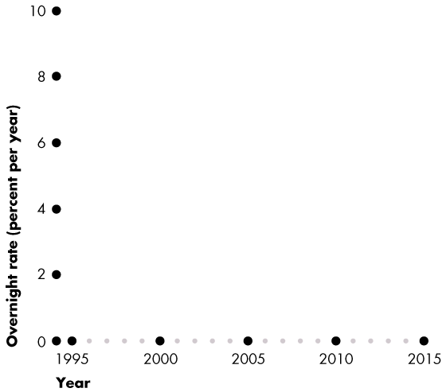
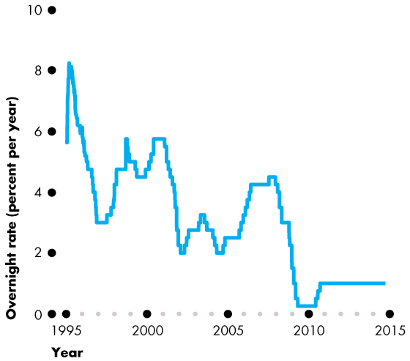
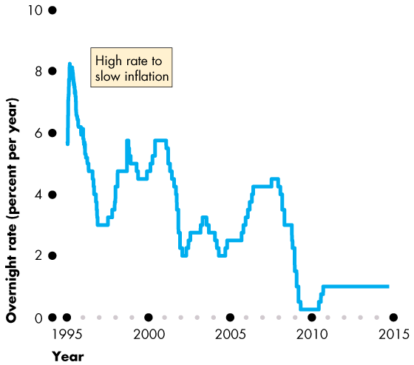
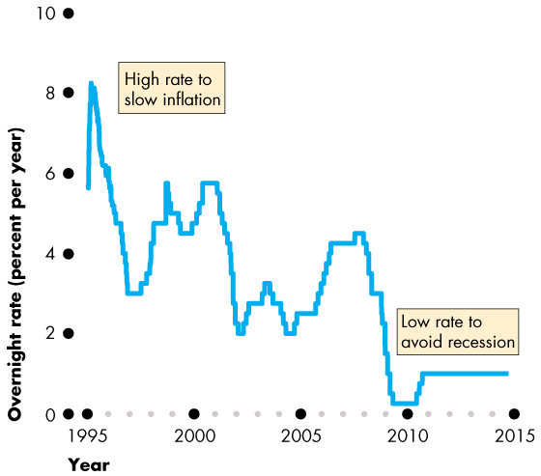
The Conduct of Monetary Policy
  Figure 30.2 shows the overnight loans rate.
  When the Bank wants to slow inflation, it raises the overnight loans rate.
  When inflation is low and the Bank wants to avoid recession, it lowers the overnight loans rate.

Slide 22
The Conduct of Monetary Policy
  Although the Bank of Canada can change the overnight loans rate by any (reasonable) amount that it chooses, it normally changes the rate by only a quarter of a percentage point.
  Having decided the appropriate level for the overnight loans rate, how does the Bank get the overnight loans rate to move to the target level?
  The answer is by using open market operations to adjust the quantity of monetary base.

Slide 23
The Conduct of Monetary Policy
  The Bank’s Interest Rate Decision
To make its interest rate decision, the Bank of Canada gathers a large amount of data about the economy, the way it responds to shocks, and the way it responds to policy.
  The Bank must then process all this data and come to a judgement about the best level for the policy instrument.
After announcing an interest rate decision, the Bank engages in a public communication to explain the reasons for its decision.

Slide 24
The Conduct of Monetary Policy
Hitting the Overnight Loans Rate Target
  Once an interest rate decision is made, the Bank of Canada achieves its target by using two tools:
  Operating band
  Open market operations

Slide 25
The Conduct of Monetary Policy
Operating Band
  The operating band is the target overnight loans rate plus or minus 0.25 percentage points. So the operating band is 0.5 percentage points wide.
  The Bank creates the operating band by setting:
  1. Bank rate, the interest rate that the Bank charges big banks on loans, is set at the target overnight loans rate plus 0.25 percentage points.
  2. Settlement balances rate, the interest rate the Bank pays on reserves, is set at the target overnight loans rate minus 0.25 percentage point.

Slide 26
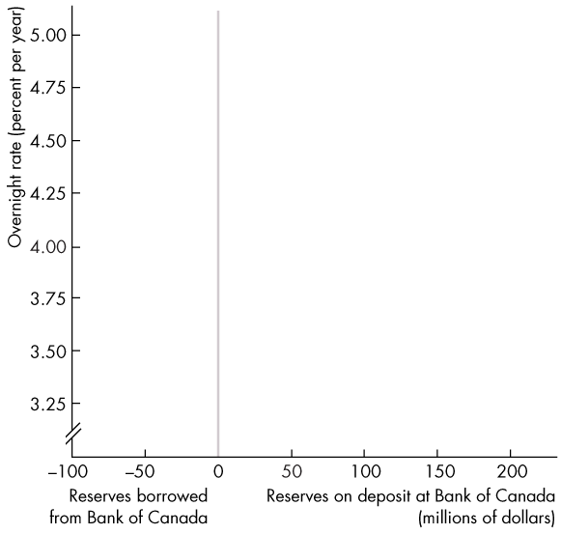
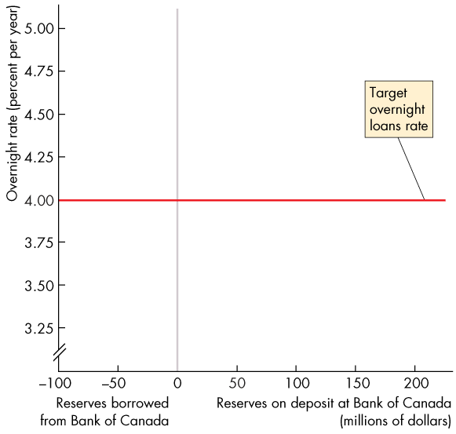
The Conduct of Monetary Policy
  Figure 30.3 illustrates the market for reserves.
  The x-axis measures the quantity of reserves held.
  The y-axis measures the overnight loans rate.
  The red line shows the target for the overnight loans rate.
Notes:
.

Slide 27
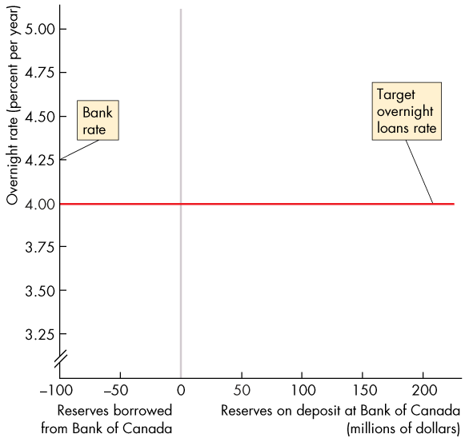
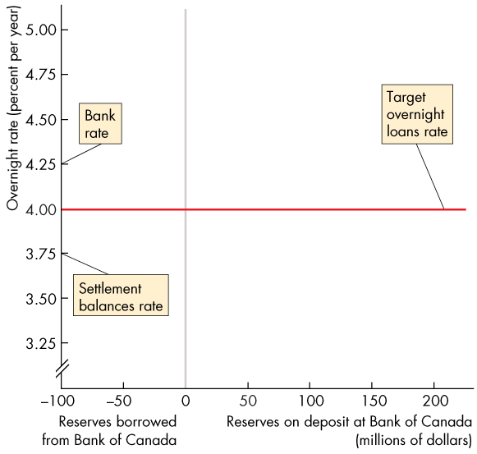
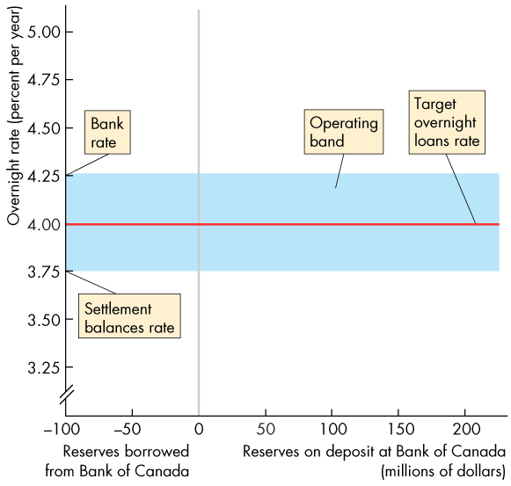
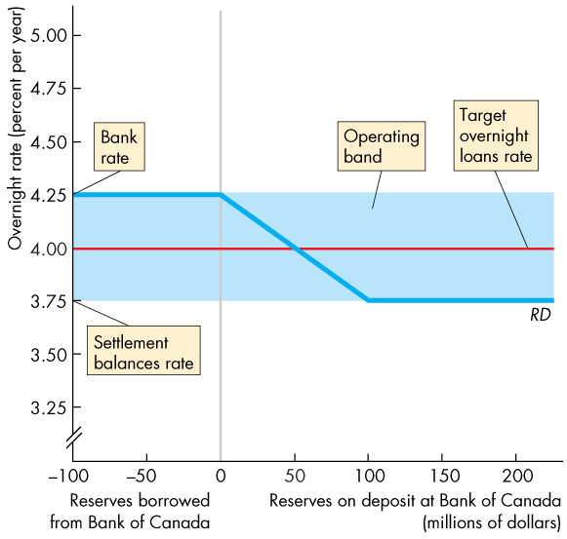
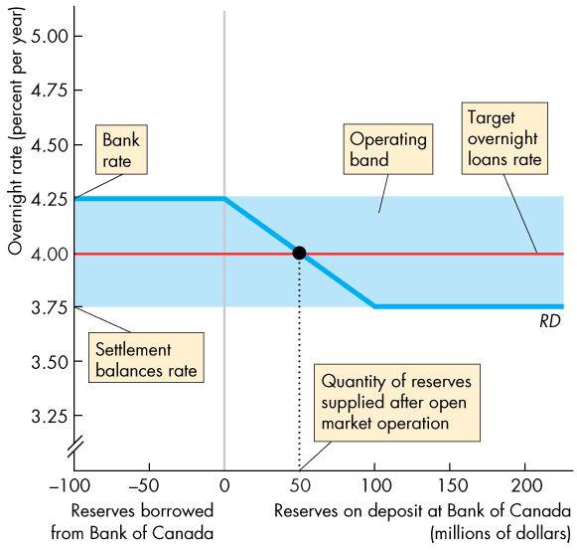

Slide 28
The Conduct of Monetary Policy
  Bank rate is set at target overnight loans rate + 0.25 percentage points.
  Settlement balances rate is set at target overnight loans rate − 0.25 percentage points.
  The blue bar is the Bank’s operating band for the actual overnight loans rate.

Slide 29
The Conduct of Monetary Policy
  The overnight loans rate cannot exceed bank rate because, if it did, a bank could make a profit by borrowing from the Bank of Canada and lending to another bank.
  But all banks can borrow from the Bank of Canada at bank rate, so no bank is willing to pay more than bank rate to borrow reserves.

Slide 30
The Conduct of Monetary Policy
  The overnight rate cannot fall below the settlement balances rate.
  If it did, a bank could make a profit by borrowing from another bank and increasing its reserves at the Bank of Canada.
  But all banks can earn the settlement balances rate, so no bank will lend at a rate below that level.

Slide 31
The Conduct of Monetary Policy
  The banks’ demand for reserves is the curve RD.
  If the overnight loans rate equals bank rate, banks are indifferent between borrowing reserves and lending reserves.
  The demand curve is horizontal at bank rate.

Slide 32
The Conduct of Monetary Policy
  If the overnight loans rate equals the settlement balances rate, banks are indifferent between holding reserves and lending reserves.
  The demand curve is horizontal at the settlement balances rate.

Slide 33
The Conduct of Monetary Policy
  If the overnight rate lies between bank rate and the settlement balances rate, banks are willing to borrow and lend to one another at the overnight rate.
  But the overnight rate is the opportunity cost of holding reserves, so the higher the overnight rate, the fewer are the reserves demanded.

Slide 34
The Conduct of Monetary Policy
  The Bank’s open market operations determine the actual quantity of reserves in the banking system.
  Equilibrium in the market for reserves—where the quantity of reserves demanded equals the quantity supplied—determines the actual overnight loans rate.

Slide 35
The Conduct of Monetary Policy
  So the Bank uses open market operations to keep the overnight loans rate on target.

Slide 36
Monetary Policy Transmission
The Bank of Canada’s goal is to keep the inflation rate as close as possible to 2 percent a year.
When the Bank uses its policy tools to move the overnight loans rate closer to its desired level, a series of events occur.
We’re now going to trace the events that follow a change in the overnight loans rate and see how those events lead to the ultimate policy goal—keeping inflation on target.
Notes:
The description of the transmission mechanism given here is very eclectic and includes all the possible channels that the literature has suggested. You might want to rebalance the emphasis toward the mechanism that you think most powerful.

Slide 37
Monetary Policy Transmission
Quick Overview
  When the Bank of Canada lowers the overnight loans rate:
  1.The Bank buys securities in an open market operation.
  2. Other short-term interest rates and the exchange rate fall.
  3. The quantity of money and the supply of loanable funds increase.
  4. The long-term real interest rate falls.
  5. Consumption expenditure, investment, and net exports increase.

Slide 38
Monetary Policy Transmission
  6. Aggregate demand increases.
  7. Real GDP growth and the inflation rate increase.
  When the Bank of Canada raises the overnight loans rate, the ripple effects go in the opposite direction.
  Figure 30.4 provides a schematic summary of these ripple effects, which stretch out over a period of between one and two years.

Slide 39


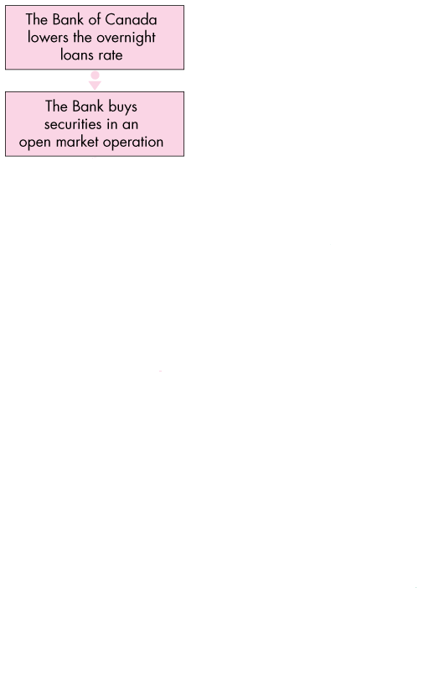
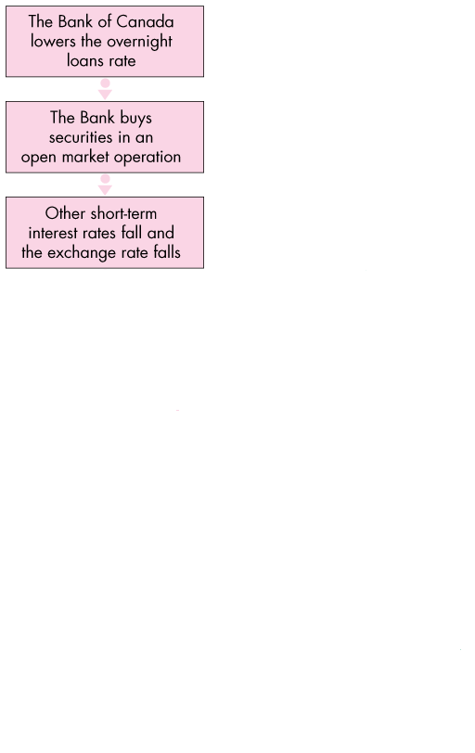
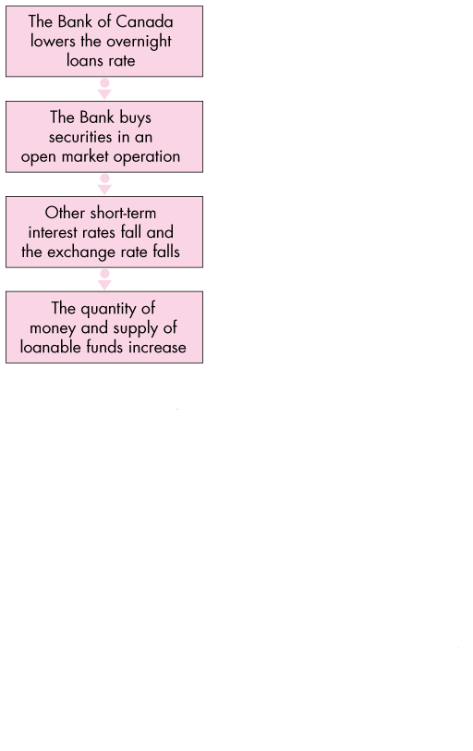
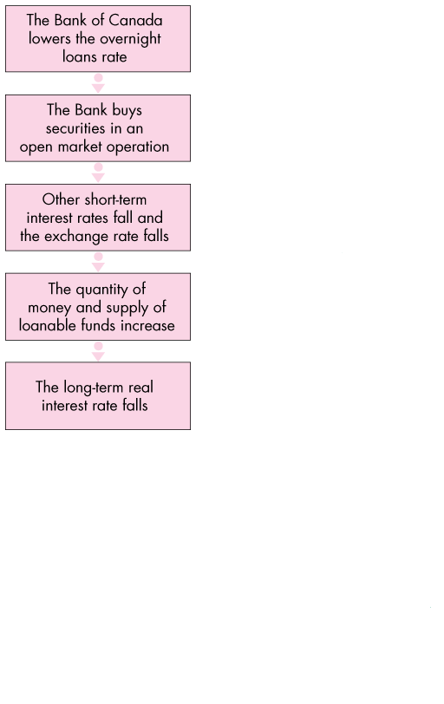
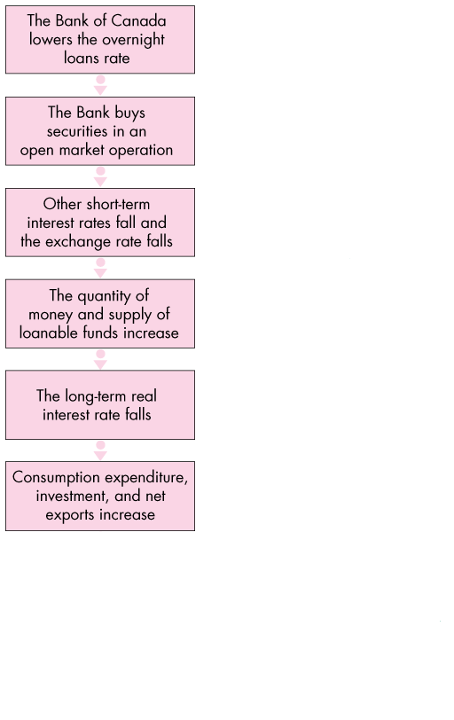
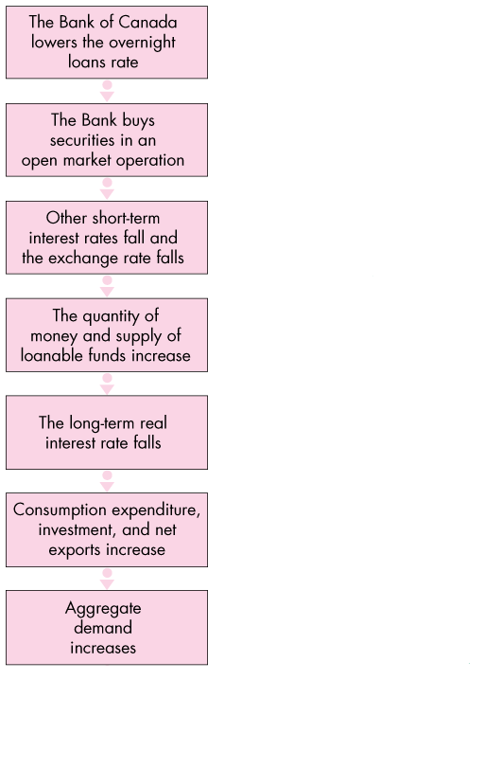
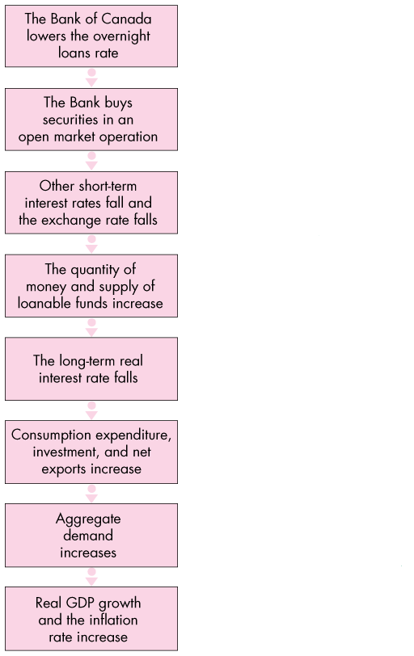
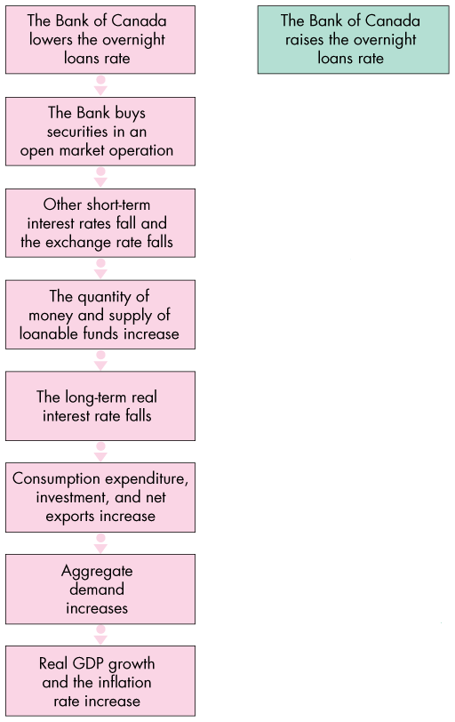
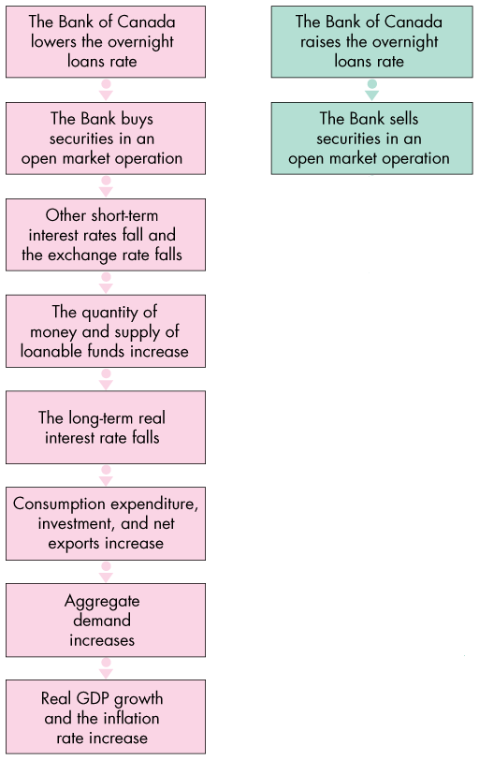
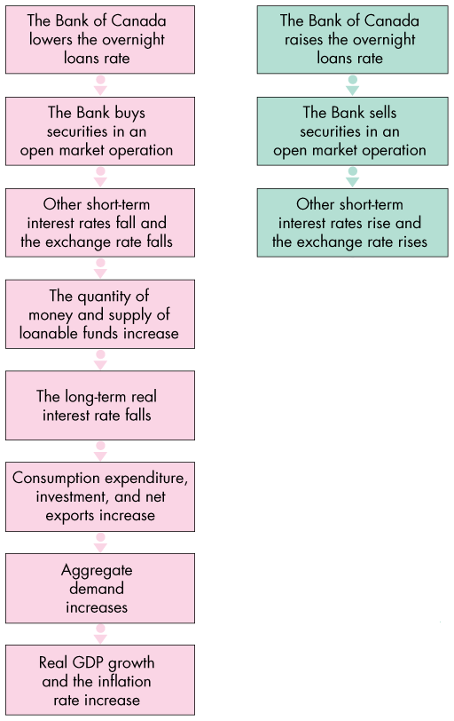
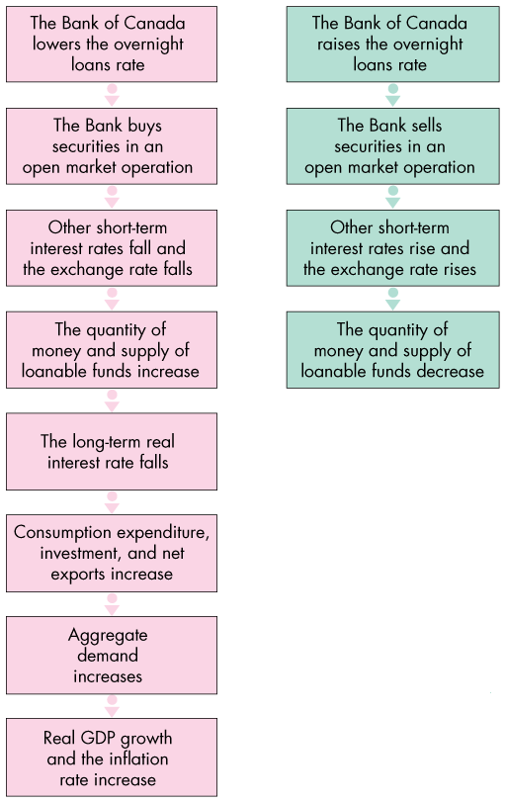
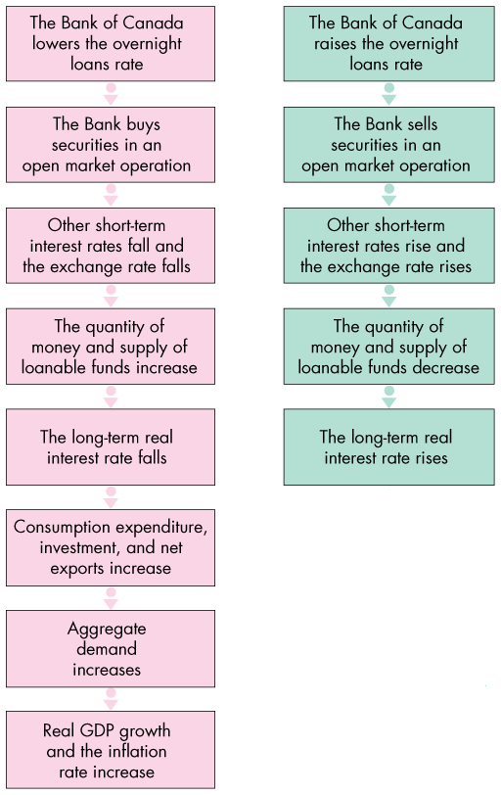
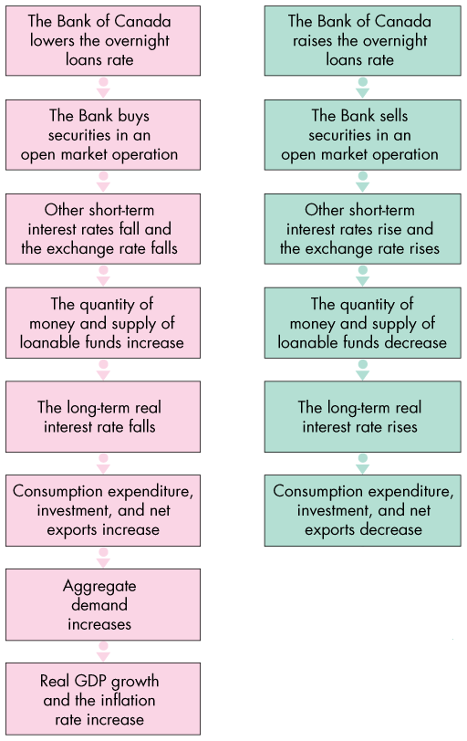
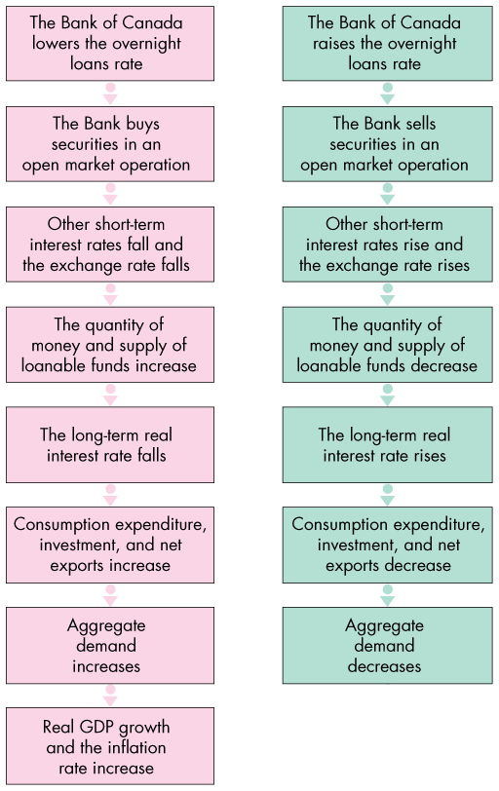
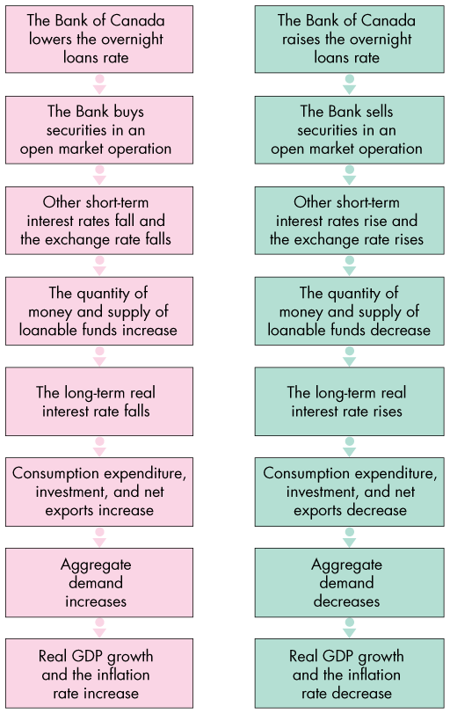
Monetary Policy Transmission

Slide 41
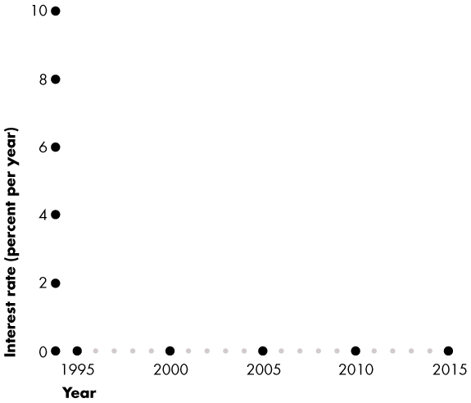
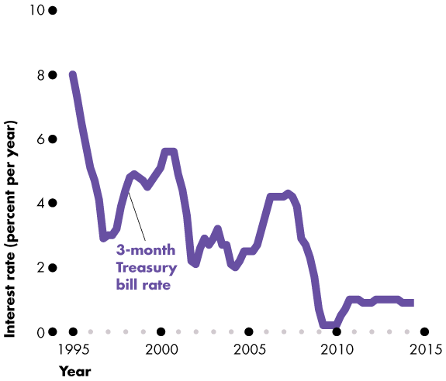
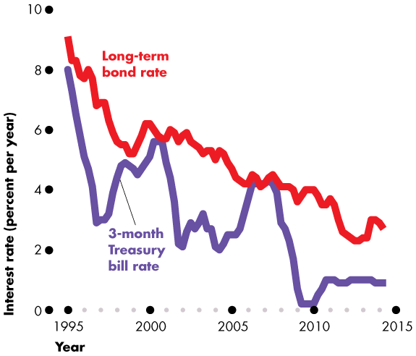
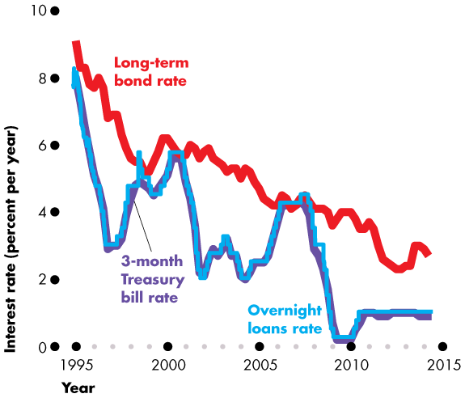
Monetary Policy Transmission
Interest Rate Changes
  Figure 30.5 shows the fluctuations in three interest rates:
  The short-term bill rate
  The long-term bond rate
  The overnight loans rate

Slide 43
Monetary Policy Transmission
  Short-term rates move closely together and follow the overnight loans rate.
  Long-term rates move in the same direction as the overnight loans rate but are only loosely connected to the overnight loans rate.

Slide 44
Monetary Policy Transmission
Exchange Rate Fluctuations
  The exchange rate responds to changes in the interest rate in Canada relative to the interest rates in other countries—the Canadian interest rate differential.
  But other factors are also at work, which make the exchange rate hard to predict.

Slide 45
Monetary Policy Transmission
Money and Bank Loans
  When the Bank lowers the overnight loans rate, the quantity of money and the quantity of bank loans increase.
  Consumption and investment plans change.
Long-Term Real Interest Rate
  Equilibrium in the market for loanable funds determines the long-term real interest rate, which equals the nominal interest rate minus the expected inflation rate.
  The long-term real interest rate influences expenditure plans.

Slide 46
Monetary Policy Transmission
Expenditure Plans
  The ripple effects that follow a change in the overnight rate change three components of aggregate expenditure:
  Consumption expenditure
  Investment
  Net exports
  A change in the overnight loans rate changes in aggregate expenditure plans, which in turn changes aggregate demand, real GDP, and the price level.
  So the Bank influences the inflation rate and output gap.

Slide 47
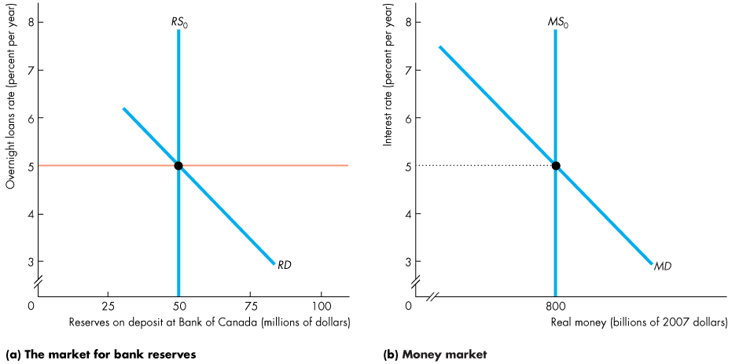
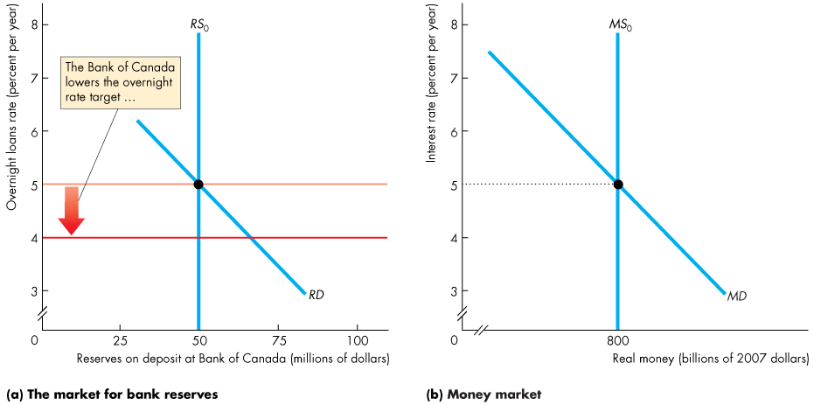
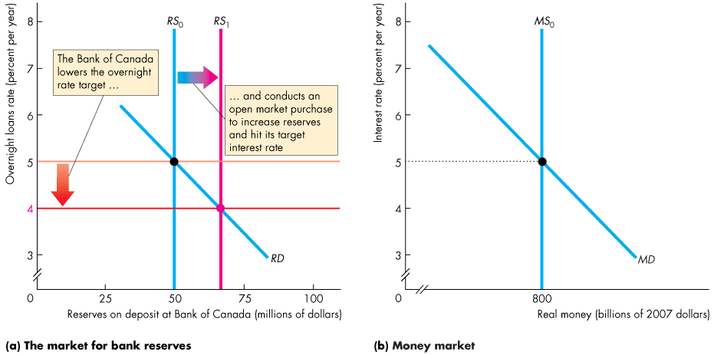
Monetary Policy Transmission
  The Bank of Canada Fights Recession
  If inflation is low and the output gap is negative, the Bank lowers the overnight rate target.
Notes:
Classroom activity
Check out Economics in in the News: The Bank of Canada Stimulus Still Needed in 2014

Slide 48
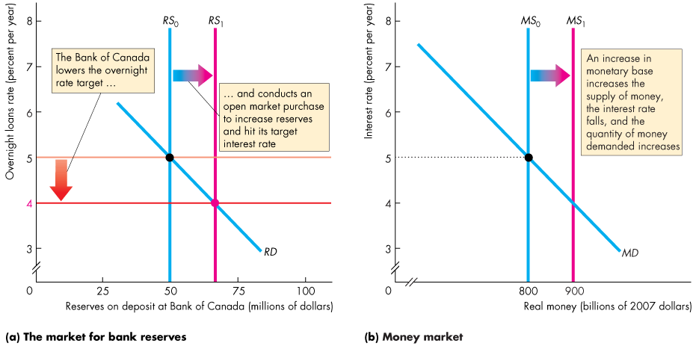


Slide 49
Monetary Policy Transmission
  An increase in the monetary base increases the supply of money.
  The short-term interest rate falls.

Slide 50
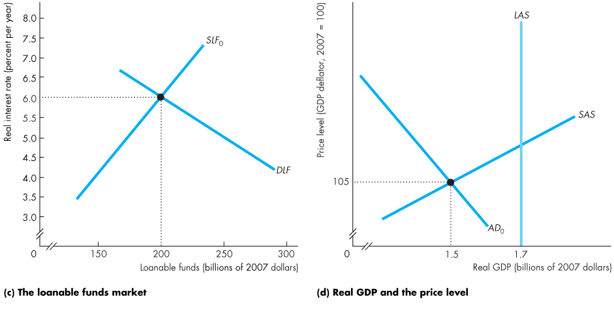
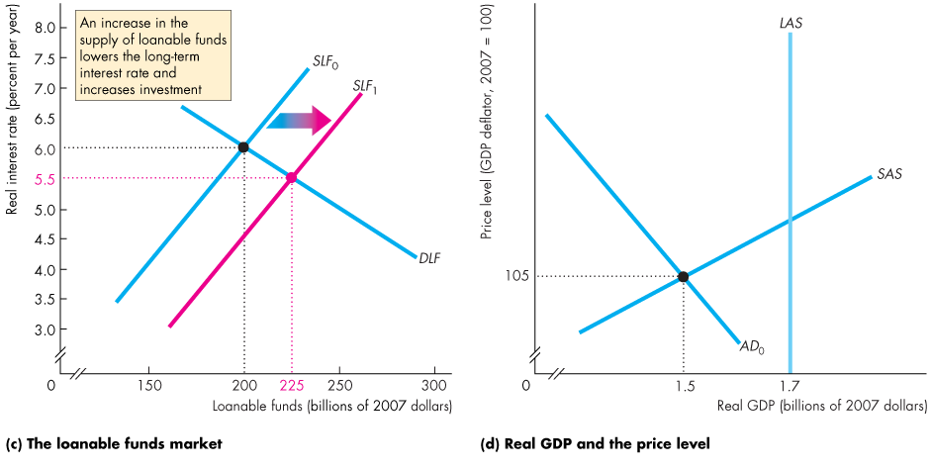
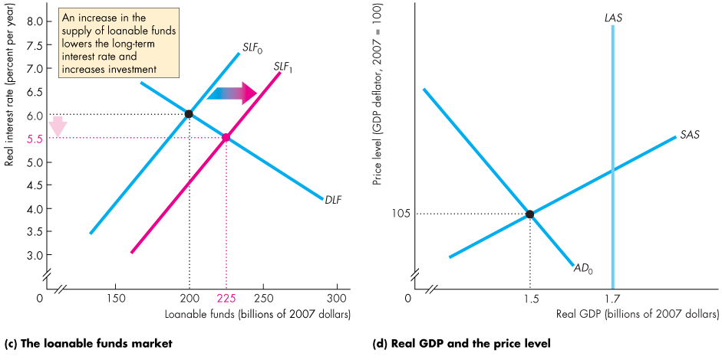

Monetary Policy Transmission
  The increase in the supply of money increases the supply of loanable funds.
  The long-term real interest rate falls. Investment increases.

Slide 51
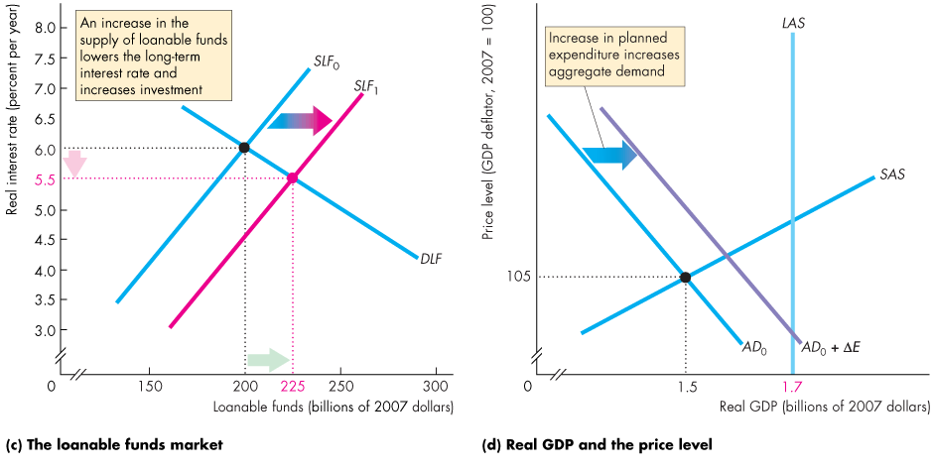
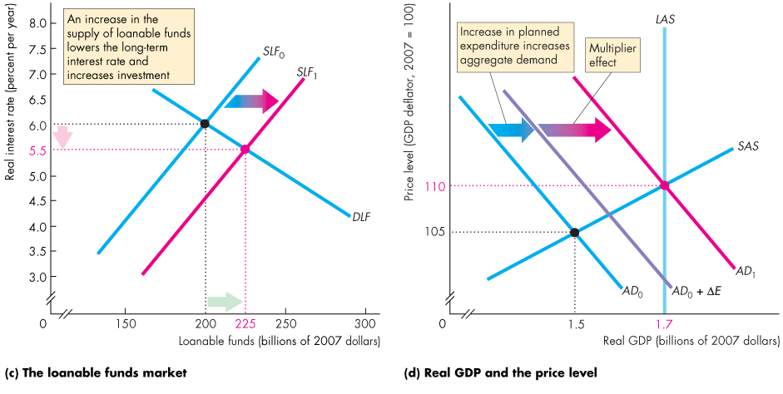

Slide 52
Monetary Policy Transmission
  The fall in the real interest rate increases aggregate planned expenditure. The multiplier increases aggregate demand.

Slide 53
Monetary Policy Transmission
  Real GDP increases and closes the recessionary gap.

Slide 54
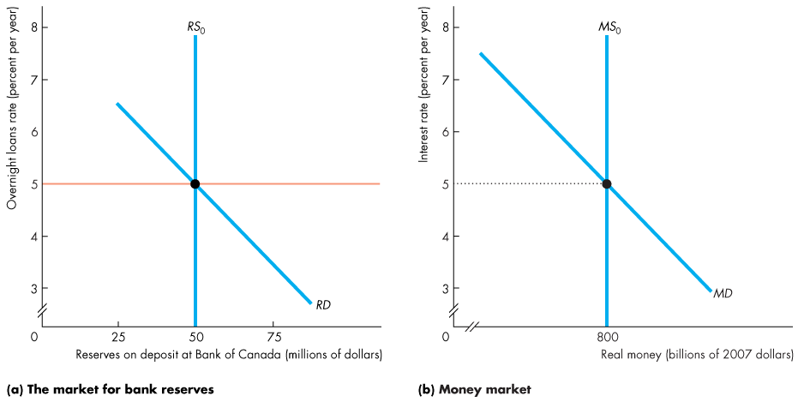
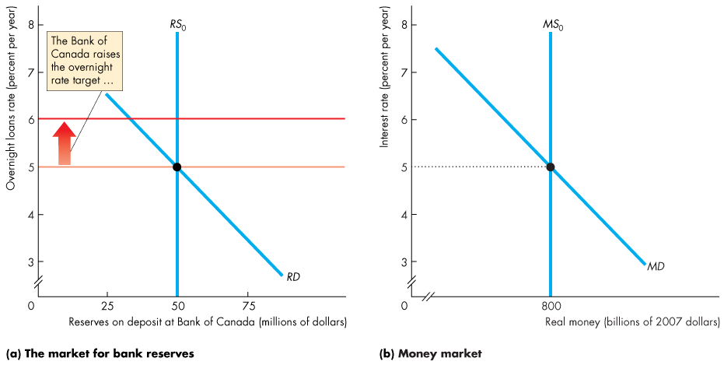
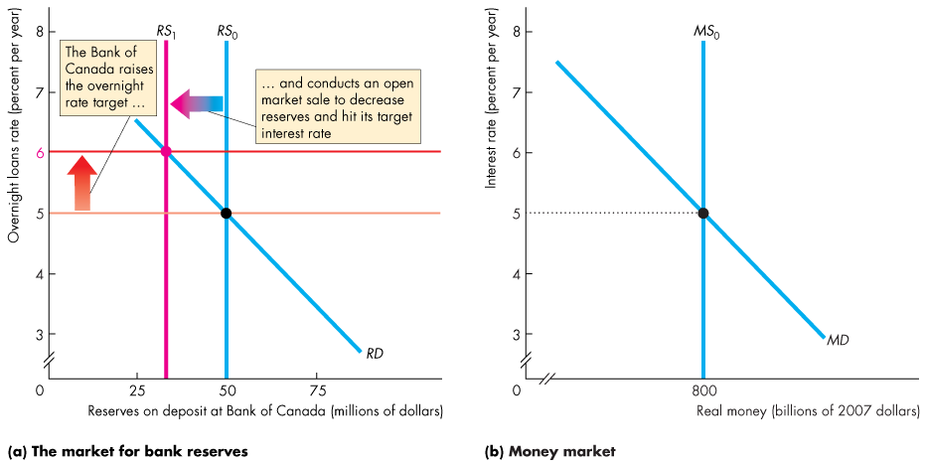
Monetary Policy Transmission
  The Bank of Canada Fights Inflation
  If inflation is too high and the output gap is positive, the Bank of Canada raises the overnight loans rate target.

Slide 55



Slide 56
Monetary Policy Transmission
  A decrease in the monetary base decreases the supply of money.
  The short-term interest rate rises.

Slide 57




Monetary Policy Transmission
  The decrease in the supply of money decreases the supply of loanable funds.
  The long-term real interest rate rises. Investment decreases.

Slide 58



Slide 59
Monetary Policy Transmission
  The rise in real interest rate decreases aggregate planned expenditure. The multiplier decreases aggregate demand.
  Real GDP decreases and closes the inflationary gap.

Slide 60
Monetary Policy Transmission
Loose Links and Long and Variable Lags
  Long-term interest rates that influence spending plans are linked loosely to the overnight loans rate.
  The response of the real long-term interest rate to a change in the nominal rate depends on how inflation expectations change.
  The response of expenditure plans to changes in the real interest rate depends on many factors that make the response hard to predict.
  The monetary policy transmission process is long and drawn out and doesn’t always respond in the same way.
Notes:
Classroom activity
Check out Economics in Action: A View of the Long and Variable Lag

Slide 61
Extraordinary Monetary Stimulus
  During the financial crisis and recession of 2008−2009, the Bank of Canada, U.S. Federal Reserve, and other central banks lowered their overnight rates to the floor.
  What can a central bank do to stimulate the economy when it cannot lower the overnight loans rate?
  The Key Elements of the Crisis
  The three main events that put banks under stress were
  Widespread fall in asset prices
  A significant currency drain
  A run on the bank

Slide 62

Extraordinary Monetary Stimulus
  When asset prices fall, banks incur a capital loss and if prices fall enough, banks’ liabilities exceed their assets.
  A large currency drain leaves the banks short of reserves.
  A run on a bank occurs when depositors lose confidence and withdraw funds. The bank loses reserves, calls in loans, sells securities at low prices, and its equity shrinks.

Slide 63
Extraordinary Monetary Stimulus
The Policy Actions
  Policy actions dribbled out for more than a year.
  Massive open market operations
  Extension of deposit insurance
  Central banks and governments swapped government securities for toxic assets
  Governments bought bank shares
  Fair value accounting
  These action provided banks with more reserves, more secure depositors, and safe liquid assets.

Slide 64
Extraordinary Monetary Stimulus
Policy Strategies and Clarity
  Two other approaches to monetary policy that other countries have used are
  Inflation rate targeting
  Policy interest rate (for the Bank of Canada, the overnight loans rate) by using a rule or formula
Notes:
If you are a passionate supporter of one of the alternative monetary policy strategies, don’t be shy about pushing it. Students like to know the passions of their teachers. I’ve tried hard to hide my passion to avoid getting in your way! MP

Slide 65
Extraordinary Monetary Stimulus
Inflation Rate Targeting
  Inflation rate targeting is a monetary policy strategy in which the central bank makes a public commitment
  1. To achieve an explicit inflation target
  2. To explain how its policy actions will achieve that target
  Several central banks practice inflation targeting and have done so since the mid-1990s.
  Inflation targeting is a strategy that avoids serious inflation and persistent deflation.

Slide 66
Extraordinary Monetary Stimulus
Policy Interest Rate Rule
The most famous and most studied interest rate rule is the Taylor rule.
  Supporters of the Taylor rule argue that by using a rule to set the interest rate, monetary policy contributes towards lessening uncertainty ….
  And with less uncertainty, financial markets, labour markets, and goods market work better as traders are more willing to make long-term commitments.
Notes:
Classroom activity
Check out Economics in Action: The Taylor Rule

